Slide 1

HTML (Hyper Text Markup Language)

Slide 2

INTRODUCTION
HTML stands for Hyper Text Markup Language
It is the standard markup language for creating Web pages
It describes the structure of a Web page
It consists of a series of elements
HTML elements tell the browser how to display the content
HTML elements label pieces of content such as "this is a heading", "this is a paragraph", "this is a link", etc.

Slide 3
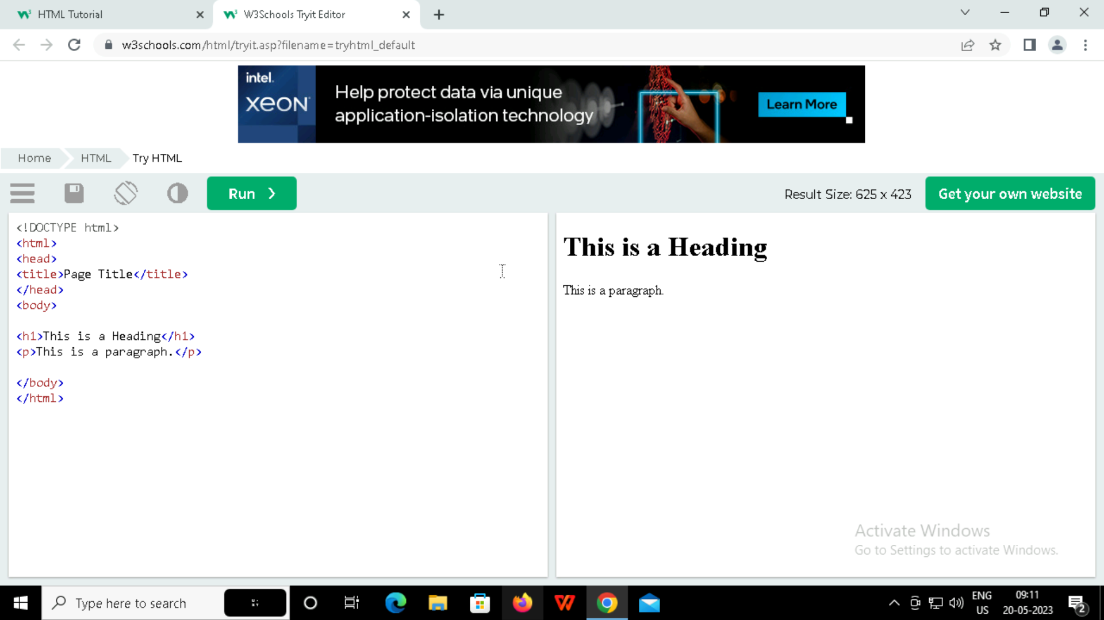
Example

Slide 4

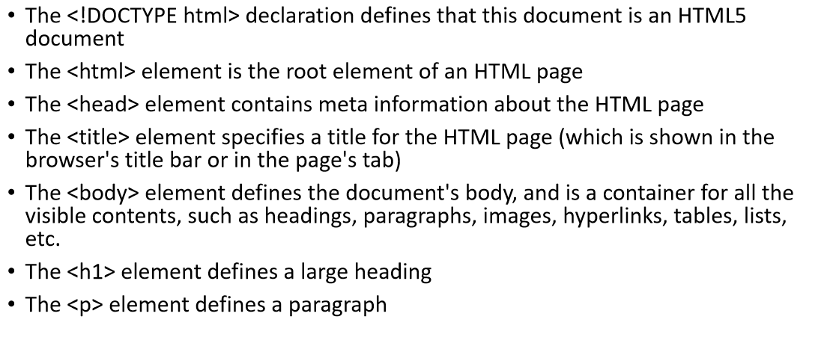

Slide 5

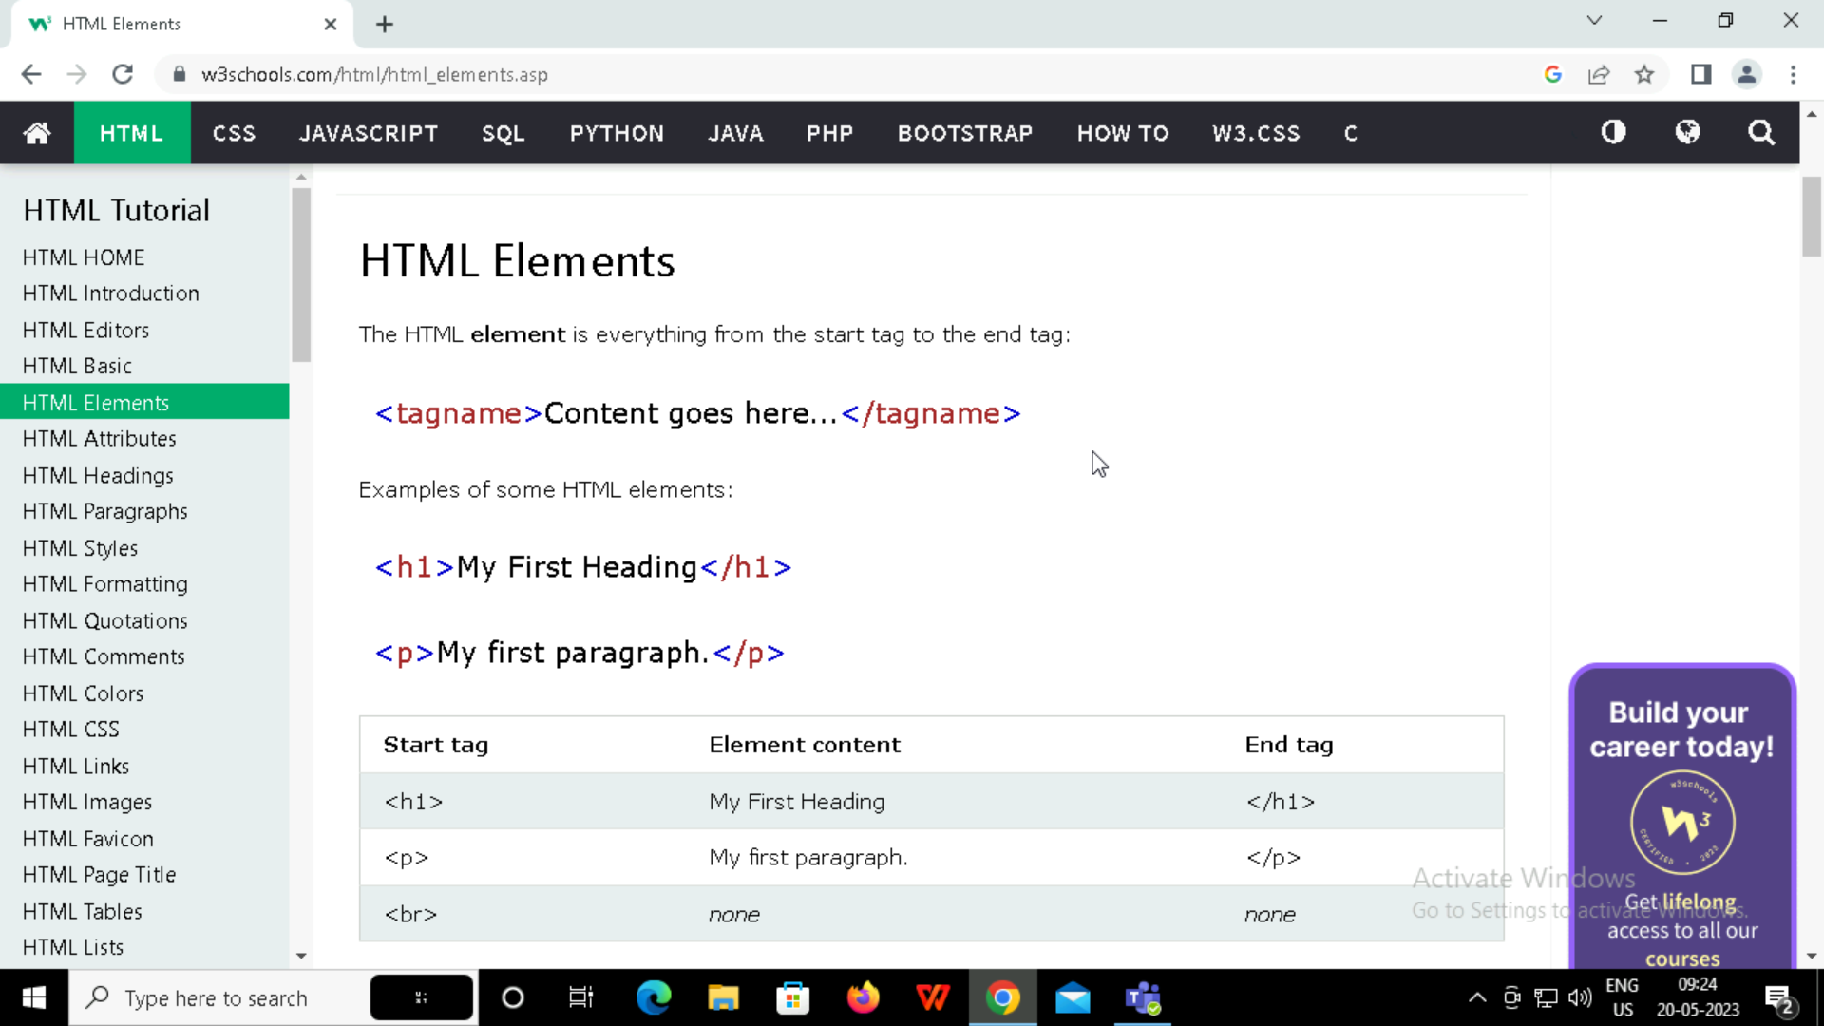
An HTML element is defined by a start tag, some content, and an end tag:
The HTML element is everything from the start tag to the end tag:

Slide 6
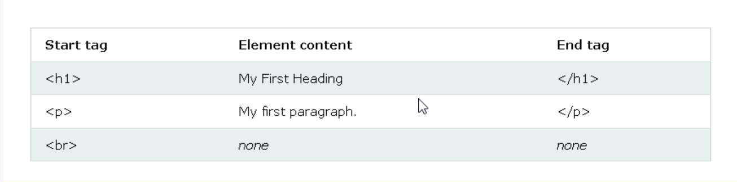
Note: Some HTML elements have no content (like the <br> element). These elements are called empty elements. Empty elements do not have an end tag!

Slide 7
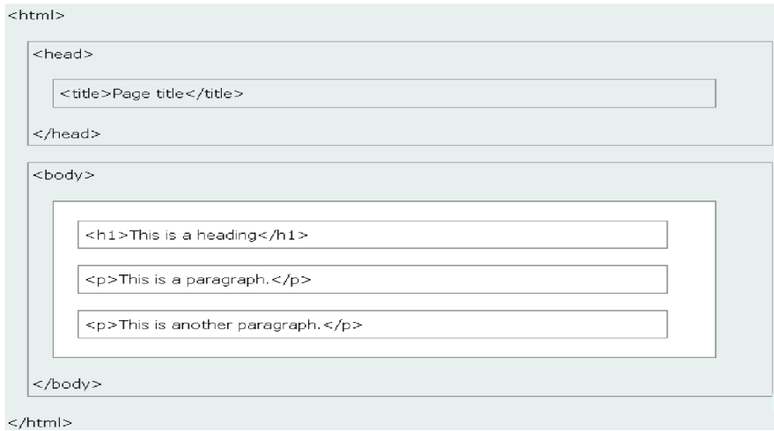
HTML Page Structure

Slide 8
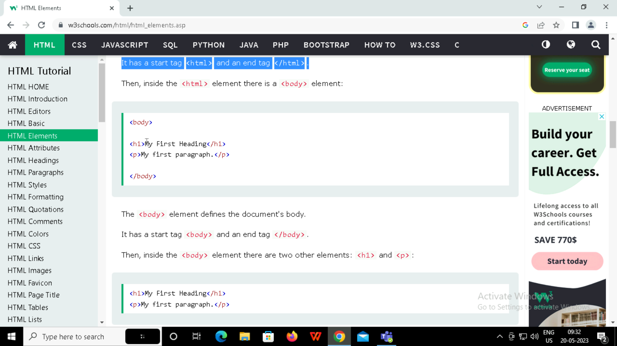
HTML Elements
The <html> element is the root element, and it defines the whole HTML document.
It has a start tag <html> and an end tag </html>.
Then, inside the <html> element there is a <body> element:

Slide 9
The <body> element defines the document's body.
It has a start tag <body> and an end tag </body>.
Then, inside the <body> element there are two other elements: <h1> and <p>:
The <h1> element defines a heading.
The <p> element defines a paragraph.

Slide 10
HTML Attributes
All HTML elements can have attributes
Attributes provide additional information about elements
Attributes are always specified in the start tag
Attributes usually come in name/value pairs like: name="value"

Slide 11
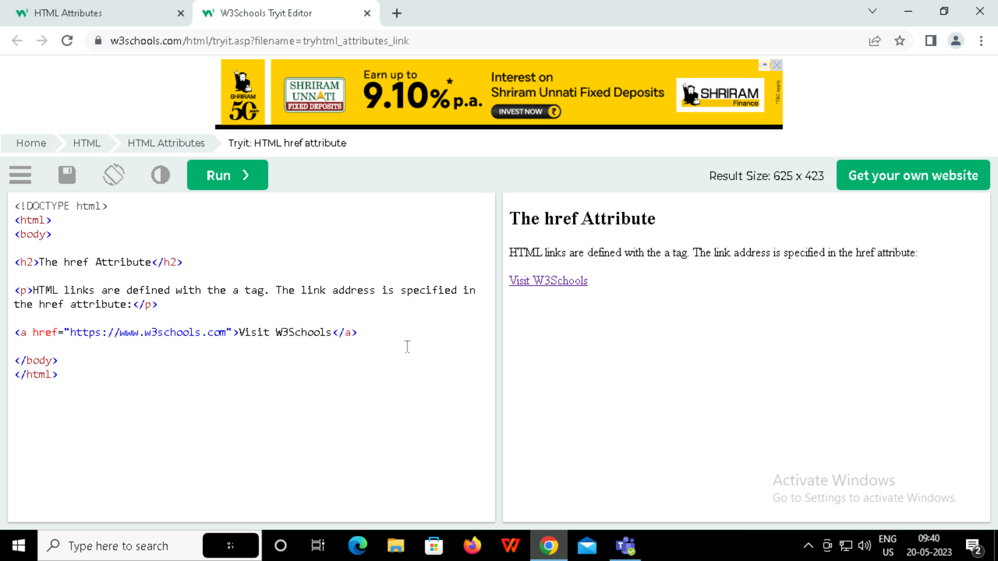
The href Attribute
The <a> tag defines a hyperlink. The href attribute specifies the URL of the page the link goes to

Slide 12
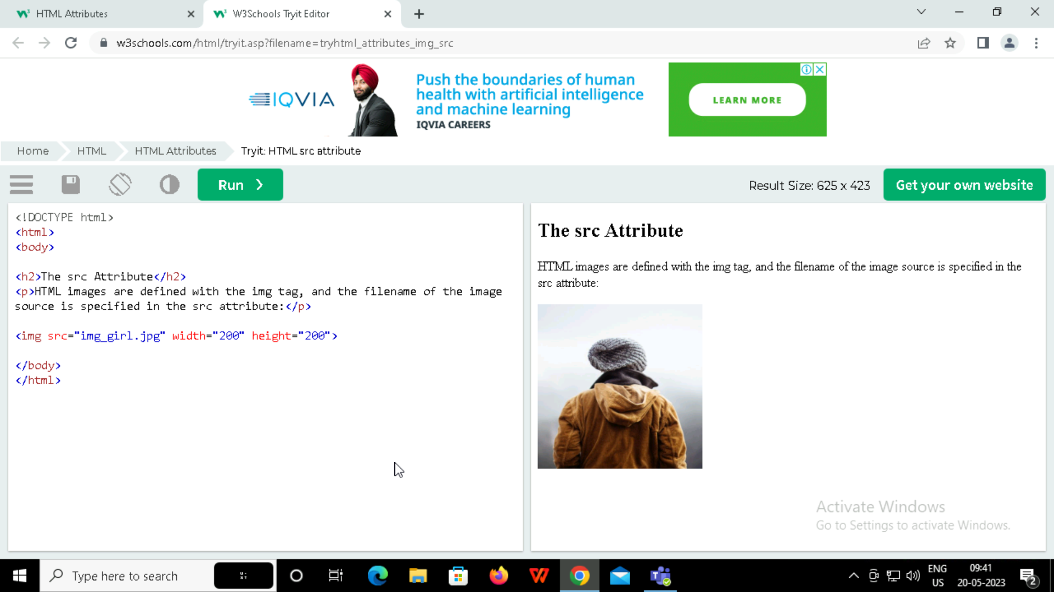
The src Attribute
The <img> tag is used to embed an image in an HTML page. The src attribute specifies the path to the image to be displayed:

Slide 13
There are two ways to specify the URL in the src attribute:
1. Absolute URL
Links to an external image that is hosted on another website.
Example: src="https://www.w3schools.com/images/img_girl.jpg".
2. Relative URL
Links to an image that is hosted within the website. Here, the URL does not include the domain name. If the URL begins without a slash, it will be relative to the current page.
Example: src="img_girl.jpg". If the URL begins with a slash, it will be relative to the domain. Example: src="/images/img_girl.jpg".

Slide 14
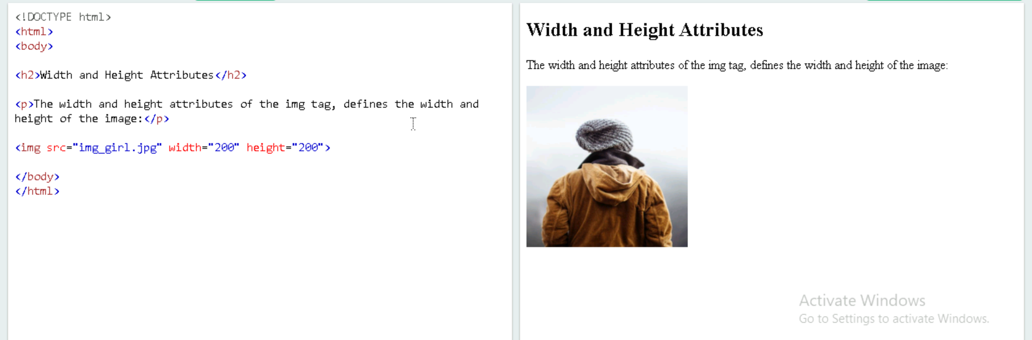
The width and height Attribute
The <img> tag should also contain the width and height attributes, which specify the width and height of the image (in pixels):

Slide 15
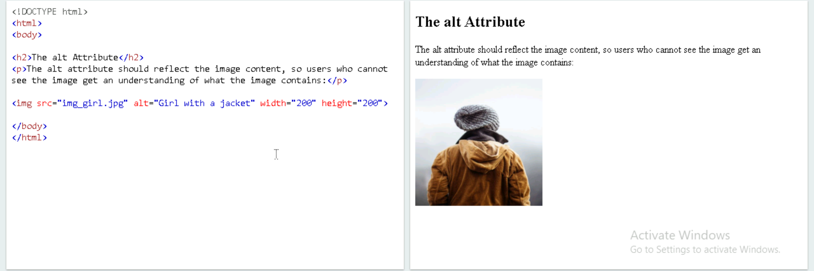
The alt Attribute
The required alt attribute for the <img> tag specifies an alternate text for an image, if the image for some reason cannot be displayed. This can be due to a slow connection, or an error in the src attribute, or if the user uses a screen reader.

Slide 16
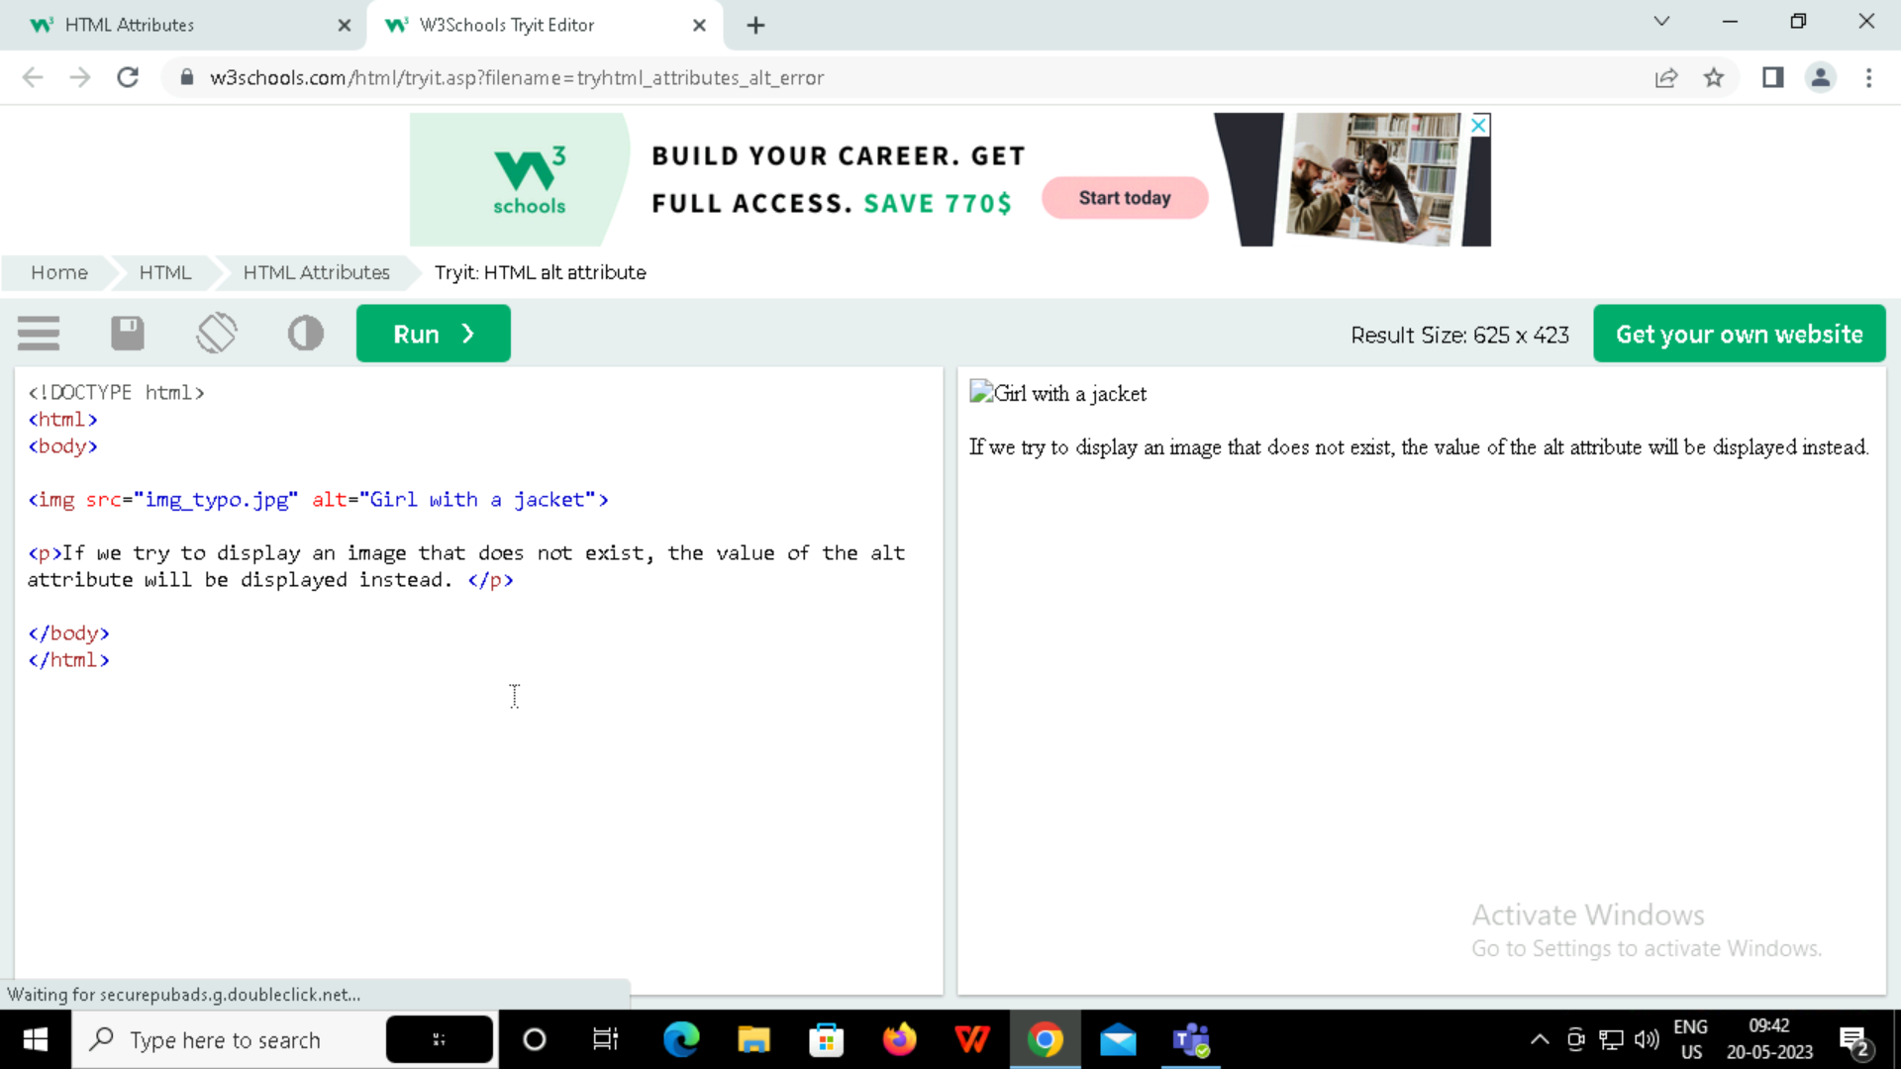
What happens if we try to display an image that does not exist?

Slide 17
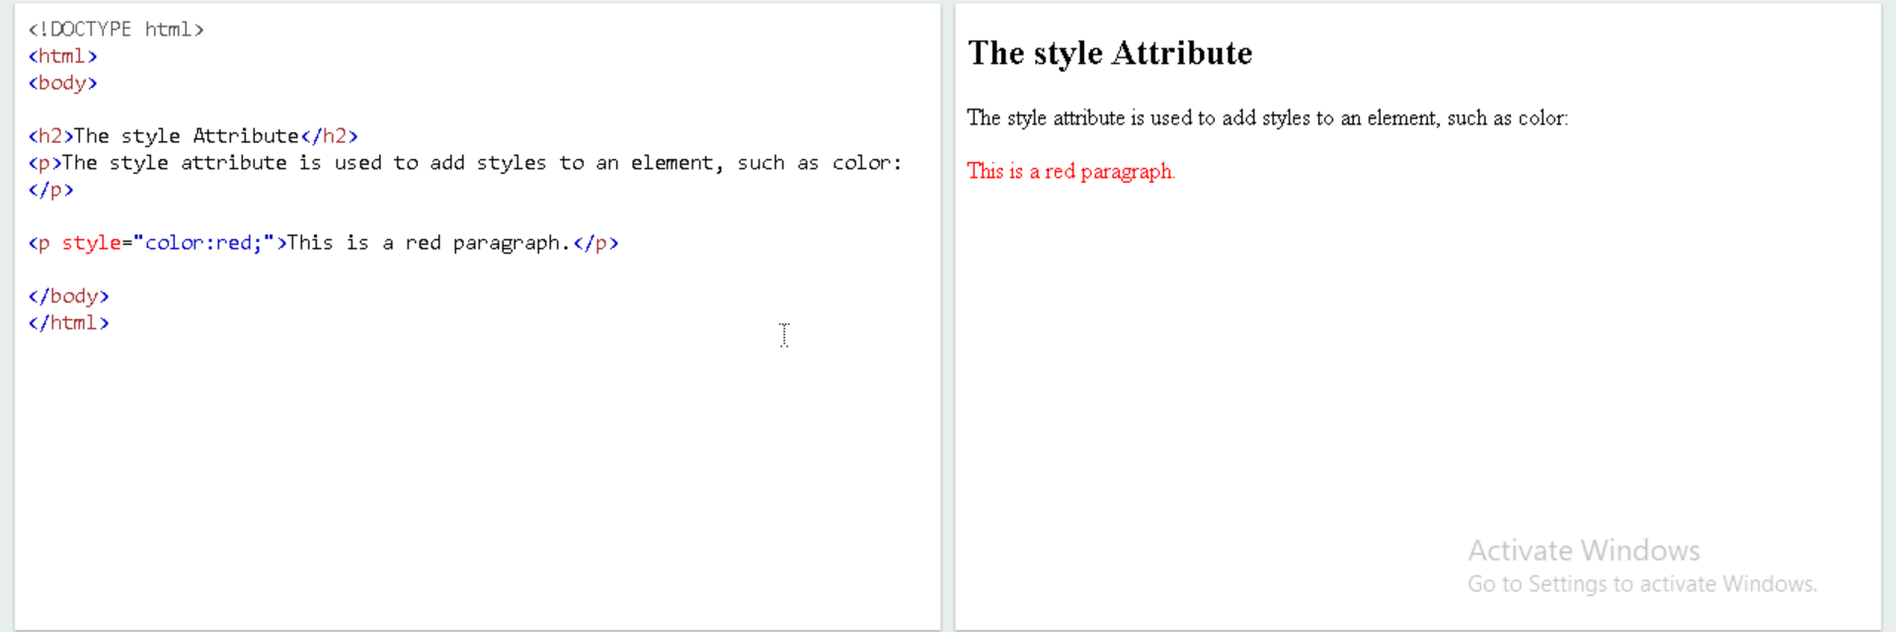
The style Attribute
The style attribute is used to add styles to an element, such as color, font, size, and more.

Slide 18
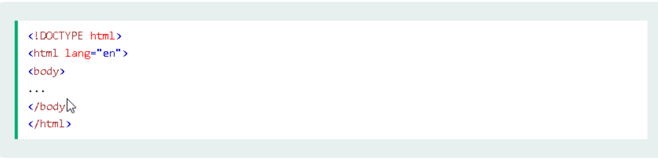
The lang Attribute
Should always include the lang attribute inside the <html> tag, to declare the language of the Web page.

Slide 19
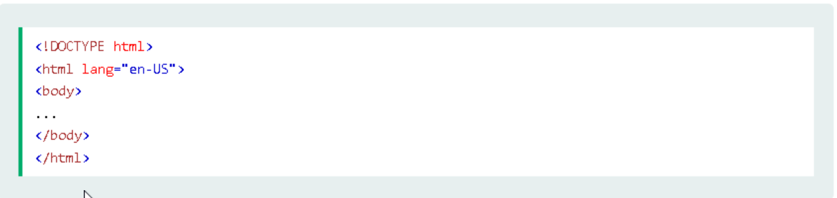
The lang Attribute
Country codes can also be added to the language code in the lang attribute. So, the first two characters define the language of the HTML page, and the last two characters define the country.

Slide 20
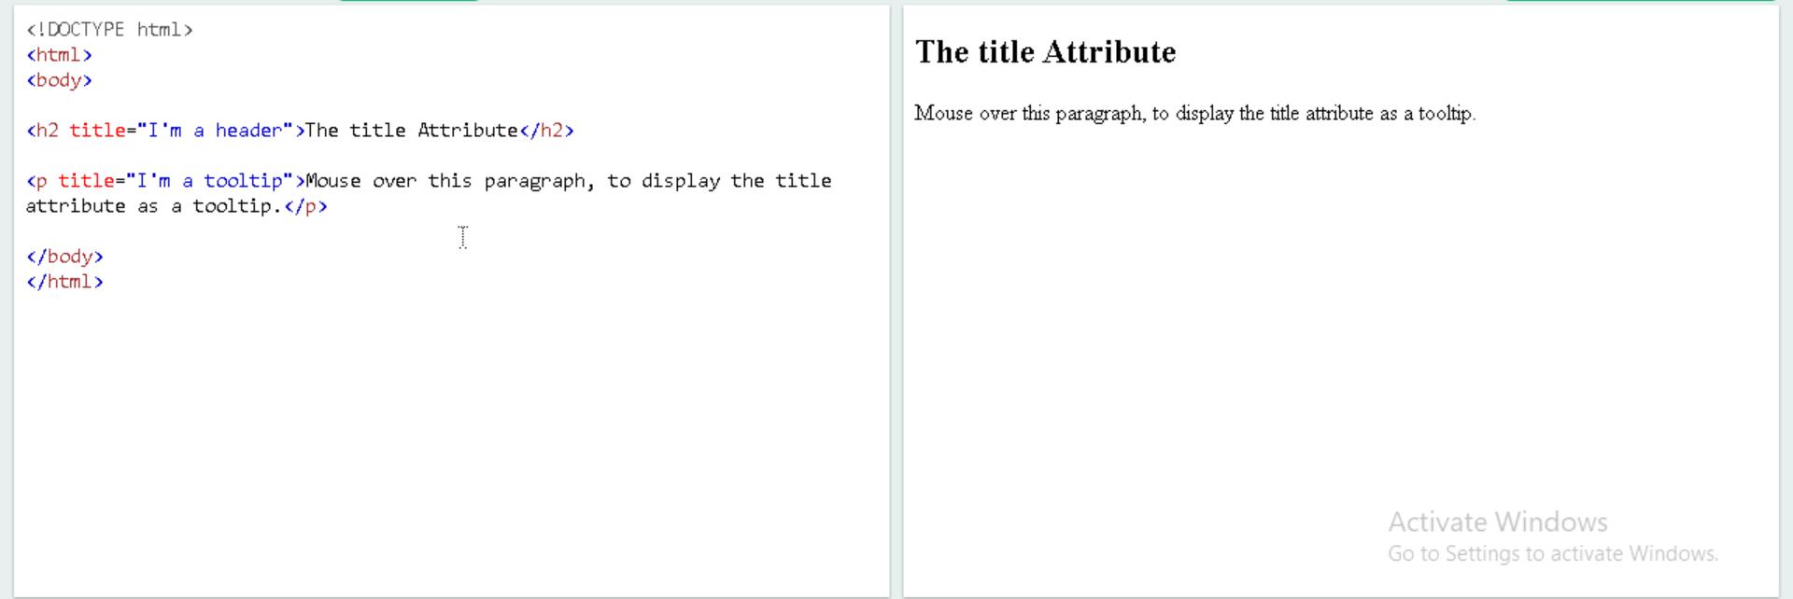
The title Attribute
The title attribute defines some extra information about an element.
The value of the title attribute will be displayed as a tooltip when you mouse over the element:

Slide 21

Summary
•All HTML elements can have attributes
•The href attribute of <a> specifies the URL of the page the link goes to
•The src attribute of <img> specifies the path to the image to be displayed
•The width and height attributes of <img> provide size information for images
•The alt attribute of <img> provides an alternate text for an image
•The style attribute is used to add styles to an element, such as color, font, size, and more
•The lang attribute of the <html> tag declares the language of the Web page
•The title attribute defines some extra information about an element

Slide 22
HTML Headings
HTML headings are defined with the <h1> to <h6> tags.
<h1> defines the most important heading. <h6> defines the least important heading.
Example:
<!DOCTYPE html>
<html>
<body>
<h1>Heading 1</h1>
<h2>Heading 2</h2>
<h3>Heading 3</h3>
<h4>Heading 4</h4>
<h5>Heading 5</h5>
<h6>Heading 6</h6>
</body>
</html>

Slide 23
HTML Paragraphs
The HTML <p> element defines a paragraph.
Example:
<!DOCTYPE html>
<html>
<body>
<p>This is a paragraph.</p>
<p>This is a paragraph.</p>
<p>This is a paragraph.</p>
</body>
</html>

Slide 24
HTML Styles
The HTML style attribute is used to add styles to an element, such as color, font, size, and more.
Example:
<!DOCTYPE html>
<html>
<body>
<p>I am normal</p>
<p style="color:red;">I am red</p>
<p style="color:blue;">I am blue</p>
<p style="font-size:50px;">I am big</p>
</body>
</html>

Slide 25
Background Color
Setting the style of an HTML element, can be done with the style attribute.
The CSS background-color property defines the background color for an HTML element.
Example:
<!DOCTYPE html>
<html>
<body style="background-color:powderblue;">
<h1>This is a heading</h1>
<p>This is a paragraph.</p>
</body>
</html>
Text Color
The CSS color property defines the text color for an HTML element.

Slide 26
Example:
<!DOCTYPE html>
<html>
<body>
<h1 style="color:blue;">This is a heading</h1>
<p style="color:red;">This is a paragraph.</p>
</body>
</html>
Fonts
The CSS font-family property defines the font to be used for an HTML element:
Example:
<!DOCTYPE html>
<html>
<body>

Slide 27
<h1 style="font-family:verdana;">This is a heading</h1>
<p style="font-family:courier;">This is a paragraph.</p>
</body>
</html>
Text Size
The CSS font-size property defines the text size for an HTML element
Example:
<h1 style="font-size:300%;">This is a heading</h1>
<p style="font-size:160%;">This is a paragraph.</p>

Slide 28
Text Alignment
The CSS text-align property defines the horizontal text alignment for an HTML element:
Example:
<h1 style="text-align:center;">Centered Heading</h1> <p style="text-align:center;">Centered paragraph.</p>

Slide 29
HTML Text Formatting
HTML Formatting Elements
Formatting elements were designed to display special types of text:
<b> - Bold text
<strong> - Important text
<i> - Italic text
<em> - Emphasized text
<mark> - Marked text
<small> - Smaller text
<del> - Deleted text
<ins> - Inserted text
<sub> - Subscript text
<sup> - Superscript text

Slide 30
HTML Quotation and Citation Elements
HTML <blockquote> for Quotations
The HTML <blockquote> element defines a section that is quoted from another source.
Browsers usually indent <blockquote> elements.
Example:
<p>Here is a quote from WWF's website:</p> <blockquote cite="http://www.worldwildlife.org/who/index.html"> For 60 years, WWF has worked to help people and nature thrive. As the world's leading conservation organization, WWF works in nearly 100 countries. At every level, we collaborate with people around the world to develop and deliver innovative solutions that protect communities, wildlife, and the places in which they live. </blockquote>

Slide 31
HTML <q> for Short Quotations
The HTML <q> tag defines a short quotation.
Browsers normally insert quotation marks around the quotation.
Example
<p>WWF's goal is to: <q>Build a future where people live in harmony with nature.</q></p>
HTML <abbr> for Abbreviations
The HTML <abbr> tag defines an abbreviation or an acronym, like "HTML", "CSS", "Mr.", "Dr.", "ASAP", "ATM".

Slide 32
HTML <address> for Contact Information
The HTML <address> tag defines the contact information for the author/owner of a document or an article.
The text in the <address> element usually renders in italic, and browsers will always add a line break before and after the <address> element.
Example:
<address> Written by John Doe.<br> Visit us at:<br> Example.com<br> Box 564, Disneyland<br> USA </address>
HTML <cite> for Work Title
The HTML <cite> tag defines the title of a creative work (e.g. a book, a poem, a song, a movie, a painting, a sculpture, etc.).
The text in the <cite> element usually renders in italic.

Slide 33
Example:
<p><cite>The Scream</cite> by Edvard Munch. Painted in 1893.</p>
HTML <bdo> for Bi-Directional Override
BDO stands for Bi-Directional Override.
The HTML <bdo> tag is used to override the current text direction.
Example:
<bdo dir="rtl">This text will be written from right to left</bdo>

Slide 34
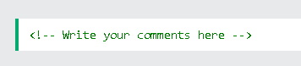
COMMENTS
You can add comments to your HTML source by using the following syntax:
Comments can be used to hide content.
This can be helpful if you hide content temporarily:

Slide 35
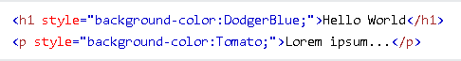
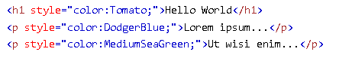
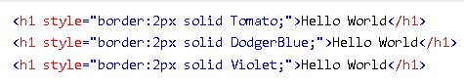
Color
HTML colors are specified with predefined color names, or with RGB, HEX, HSL, RGBA, or HSLA values
Background color:
Text-Color:
Border Color

Slide 36
RGB Color value
In HTML, a color can be specified as an RGB value, using this formula:
rgb(red, green, blue)
Each parameter (red, green, and blue) defines the intensity of the color with a value between 0 and 255.
This means that there are 256 x 256 x 256 = 16777216 possible colors!
Hex Color Value
In HTML, a color can be specified using a hexadecimal value in the form:
#rrggbb
Where rr (red), gg (green) and bb (blue) are hexadecimal values between 00 and ff (same as decimal 0-255).
For example, #ff0000 is displayed as red, because red is set to its highest value (ff), and the other two (green and blue) are set to 00.

Slide 37
HSL Color Value
In HTML, a color can be specified using hue, saturation, and lightness (HSL) in the form:
hsl(hue, saturation, lightness)
Hue is a degree on the color wheel from 0 to 360. 0 is red, 120 is green, and 240 is blue.

Slide 38
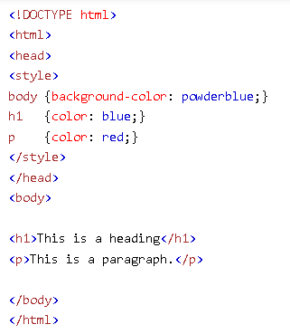
HTML CSS
Cascading Style Sheets (CSS) is used to format the layout of a webpage.
CSS can be added to HTML documents in 3 ways:
Inline - by using the style attribute inside HTML elements
<h1 style="color:blue;">A Blue Heading</h1>
Internal - by using a <style> element in the <head> section

Slide 39
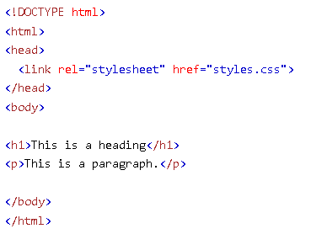
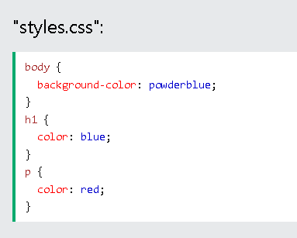
External - by using a <link> element to link to an external CSS file

Slide 40
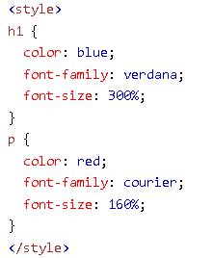
Css Color,Font,Size
The CSS color property defines the text color to be used.
The CSS font-family property defines the font to be used.
The CSS font-size property defines the text size to be used.

Slide 41
HTML Links
HTML links are hyperlinks.
You can click on a link and jump to another document.
When you move the mouse over a link, the mouse arrow will turn into a little hand.
<a href="url">link text</a>
The target attribute can have one of the following values:
_self - Default. Opens the document in the same window/tab as it was clicked
_blank - Opens the document in a new window or tab
_parent - Opens the document in the parent frame
_top - Opens the document in the full body of the window

Slide 42
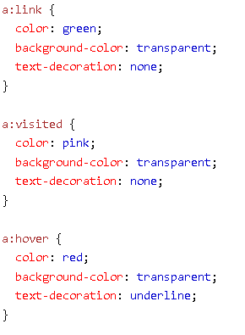
HTML Color Link
An unvisited link is underlined and blue
A visited link is underlined and purple
An active link is underlined and red

Slide 43
HTML Images
Images can improve the design and the appearance of a web page.
The <img> tag has two required attributes.
src - Specifies the path to the image
alt - Specifies an alternate text for the image
Syntax- <img src="url" alt="alternatetext">
You can use the style attribute to specify the width and height of an image.
Example : <img src="img_girl.jpg" alt="Girl in a jacket" style="width:500px;height:600px;">

Slide 44
Image File Formats
Different file formats are commonly used for web images:
JPEG: Suitable for photographs and complex images.
PNG: Supports transparency and ideal for graphics and logos.
GIF: Supports animation and limited color palette.
Specify the image dimensions using the width and height attributes.
Use CSS to set dimensions or apply responsive design techniques.
Example: <img src="image.jpg" alt="Image" width="500" height="300">

Slide 45
Image Size and Dimensions
Specify the image dimensions using the width and height attributes.
Use CSS to set dimensions or apply responsive design techniques.
Example: <img src="image.jpg" alt="Image" width="500" height="300">
Use CSS to control image alignment and positioning within the page.
Common CSS properties include float, margin, and display.
Example: <img src="image.jpg" alt="Image" style="float: left; margin-right: 10px;">

Slide 46
Responsive images
Ensure images adapt to different screen sizes and devices.
Use CSS media queries, viewport units, or frameworks like Bootstrap.
Example: <img src="image.jpg" alt="Image" style="max-width: 100%; height: auto;">
Compress and optimize images for faster loading.
Tools like Adobe Photoshop, TinyPNG, or online image compressors can help.
Consider lazy loading techniques to improve page performance.

Slide 47
HTML Image Maps
Used to create clickable areas on an image.
An HTML image map is a way to define clickable areas on an image.
It allows you to assign different links or actions to specific regions of an image.
Image maps are widely used to create interactive and engaging web content.

Slide 48
Types of Image Maps
Client-side image maps are the most common type.
They are created using HTML and CSS without the need for server-side processing.
Server-side image maps involve using server-side scripting languages like PHP.
Server-side image maps provide more flexibility and dynamic functionality.

Slide 49
Creating an Image Map
To create an image map in HTML, use the <map> and <area> elements.
The <map> element defines the entire image map, and the <area> element defines each clickable area.
Each <area> element is associated with a specific shape (rect, circle, or poly) and coordinates that define its position.

Slide 50
Shape Options
Rectangular areas (rect) are defined by specifying the top-left and bottom-right coordinates.
Circular areas (circle) are defined by specifying the center coordinates and the radius.
Polygonal areas (poly) are defined by providing a series of coordinates that form the shape.

Slide 51
Coordinating and Mapping
Coordinating the clickable areas with image positions is crucial for accurate mapping.
Ensure that the image and the clickable areas have the same dimensions and aspect ratio.
Use image editing tools or online image map generators to easily obtain the coordinates.

Slide 52
Linking to Web Pages
Use the href attribute in the <area> element to define the destination URL for each clickable area.
You can link to other web pages, specific sections within a page, or external resources.

Slide 53
Styling Image Maps
Apply CSS styles to enhance the appearance of image maps.
Customize the look of the clickable areas using background colors, borders, and hover effects.
Use CSS classes or inline styles to target specific areas and apply different styles.

Slide 54
How to give Image Map
The image is inserted using the <img> tag. The only difference from other images is that you must add a usemap attribute.
<img src="workplace.jpg" alt="Workplace" usemap="#workmap">
The <map> element is used to create an image map, and is linked to the image by using the required name attribute
<map name="workmap">

Slide 55
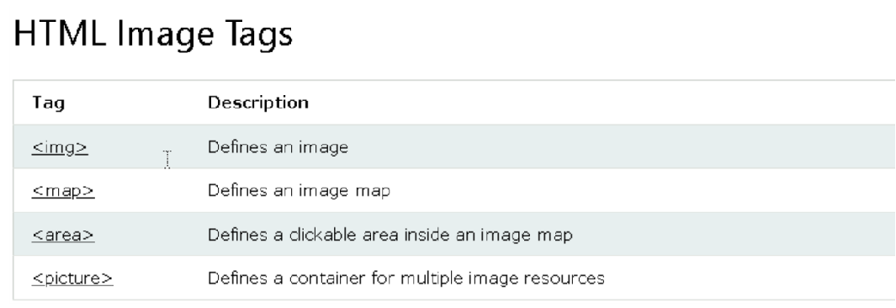
Confidential and Proprietary. ©2023 UST Inc
55

Slide 56
HTML Background Images
Definition of HTML background images
Importance and benefits of using background images in web design
Overview of how background images are implemented in HTML

Slide 57
Background Image Property
Explanation of the CSS background-image property
How the property is used to set a background image for an HTML element
Syntax example: background-image: url("image.jpg");

Slide 58
Inline Background Images
How to set an inline background image using the style attribute
Example of inline background image syntax:
<div style="background-image: url('image.jpg');"></div>

Slide 59
Background Image Size and Position
Controlling the size and positioning of background images
Overview of the background-size and background-position properties
Examples of different background image sizing and positioning options

Slide 60
Background Image Repeat
Understanding how background images repeat by default
Introduction to the background-repeat property
Examples of different repeat options: repeat, repeat-x, repeat-y, and no-repeat

Slide 61
Background Image Attachment
Exploring the background-attachment property
Differentiating between scroll and fixed attachment options
Example of fixed attachment syntax: background-attachment: fixed;

Slide 62
Background Image Shorthand
The shorthand background property for setting multiple background properties
Syntax example: background: url("image.jpg") no-repeat center center/cover;

Slide 63
Background Image Best Practices
Tips for selecting and optimizing background images
Ensuring image file sizes are optimized for web performance
Considering responsiveness and mobile devices in background image design

Slide 64
Background Image Examples
Showcase a few examples of websites or web elements with creative and effective background images
Discuss the impact of background images on the overall design and user experience

Slide 65
HTML <picture> Element
Brief overview of the HTML <picture> element
Explanation of its purpose and benefits
Importance of responsive images in web design

Slide 66
The Need for Responsive Images
Discuss the challenges posed by different device resolutions and screen sizes
Importance of delivering appropriately sized images for optimal user experience
Introduction to the concept of responsive web design

Slide 67
Introducing the <picture> Element
Definition and purpose of the <picture> element
Explanation of how it works in conjunction with the <source> and <img> elements
Its role in providing different image sources for different conditions

Slide 68
Syntax of the <picture> Element
Example code demonstrating the basic structure of the <picture> element
Usage of the <source> and <img> elements within the <picture> element

Slide 69
Multiple Source Options with <source>
Explanation of the <source> element's attributes: srcset, media, and type
Demonstration of providing multiple image sources for different scenarios
Examples of using different file formats (e.g., JPEG, PNG, WebP) for various browser support

Slide 70
Fallback <img> for Compatibility
Importance of including a fallback <img> element within the <picture> element
Explanation of the src attribute in the <img> element as a fallback source
Example code showcasing the proper usage of the fallback <img> element

Slide 71
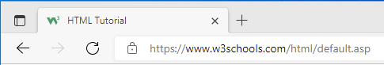
HTML Favicon
.A favicon is a small image displayed next to the page title in the browser tab.
How To Add a Favicon in Html
A favicon image is displayed to the left of the page title in the browser tab, like this:
To add a favicon to your website, either save your favicon image to the root directory of your webserver, or create a folder in the root directory called images, and save your favicon image in this folder. A common name for a favicon image is "favicon.ico".

Slide 72
Example
<!DOCTYPE html> <html> <head> <title>My Page Title</title> <link rel="icon" type="image/x-icon" href="/images/favicon.ico"> </head> <body> <h1>This is a Heading</h1> <p>This is a paragraph.</p> </body> </html>
.

Slide 73
HTML Page Title
Every web page should have a page title to describe the meaning of the page.
Example
<!DOCTYPE html> <html> <head> <title>HTML Tutorial</title> </head> <body> The content of the document...... </body> </html>

Slide 74
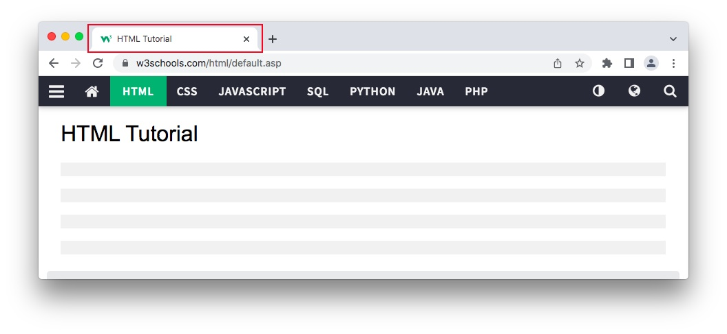
The title is shown in the browser's title bar:
.
The <title> element:
defines a title in the browser toolbar
provides a title for the page when it is added to favorites
displays a title for the page in search engine-results

Slide 75
HTML Tables
HTML tables allow web developers to arrange data into rows and columns.
Company | Contact | Country
Alfreds Futterkiste | Maria Anders | Germany
Centro comercial Moctezuma | Francisco Chang | Mexico
Ernst Handel | Roland Mendel | Austria
Island Trading | Helen Bennett | UK
Laughing Bacchus Winecellars | Yoshi Tannamuri | Canada
Magazzini Alimentari Riuniti | Giovanni Rovelli | Italy

Slide 76
Table Cells
Each table cell is defined by a <td> and a </td> tag.
td stands for table data.
Example
<table> <tr> <td>Emil</td> <td>Tobias</td> <td>Linus</td> </tr> </table>

Slide 77
HTML Page Title
Every web page should have a page title to describe the meaning of the page.
Example
<!DOCTYPE html> <html> <head> <title>HTML Tutorial</title> </head> <body> The content of the document...... </body> </html>

Slide 78
HTML Lists
HTML lists allow web developers to group a set of related items in list
Example
An unordered HTML list:
Item
Item
Item
Item
An ordered HTML list:
First item
Second item
Third item
Fourth item

Slide 79
Unordered HTML List
An unordered list starts with the <ul> tag. Each list item starts with the <li> tag
The list items will be marked with bullets (small black circles) by default:
Example
<ul> <li>Coffee</li> <li>Tea</li> <li>Milk</li> </ul>

Slide 80
Ordered HTML List
An ordered list starts with the <ol> tag. Each list item starts with the <li> tag.
The list items will be marked with numbers by default:
Example
<ol> <li>Coffee</li> <li>Tea</li> <li>Milk</li> </ol>

Slide 81
HTML Block and Inline Elements
Every HTML element has a default display value, depending on what type of element it is
There are two display values: block and inline.
Block-level Elements
Two commonly used block elements are: <p> and <div>.
The <p> element defines a paragraph in an HTML document.
The <div> element defines a division or a section in an HTML document.
Example
<p>Hello World</p> <div>Hello World</div>

Slide 82
Inline Elements
An inline element does not start on a new line.
An inline element only takes up as much width as necessary.
This is a <span> element inside a paragraph.
Example
<span>Hello World</span>

Slide 83
HTML class Attribute
<!DOCTYPE html> <html> <head> <style> .note { font-size: 120%; color: red; } </style> </head> <body> <h1>My <span class="note">Important</span> Heading</h1> <p>This is some <span class="note">important</span> text.</p> </body> </html>
The HTML class attribute is used to specify a class for an HTML element.
It can also be used by a JavaScript to access and manipulate elements with the specific class name.
In the following example we have two <span> elements with a class attribute with the value of "note". Both <span> elements will be styled equally according to the .note style definition in the head section:

Slide 84
HTML id Attribute
<!DOCTYPE html> <html> <head> <style> #myHeader { background-color: lightblue; color: black; padding: 40px; text-align: center; } </style> </head> <body> <h1 id="myHeader">My Header</h1> </body> </html>
The HTML id attribute is used to specify a unique id for an HTML element.
The id attribute is used to point to a specific style declaration in a style sheet
In the following example we have an <h1> element that points to the id name "myHeader". This <h1> element will be styled according to the #myHeader style definition in the head section:

Slide 85
HTML Iframes
An HTML iframe is used to display a web page within a web page.
The HTML <iframe> tag specifies an inline frame.
An inline frame is used to embed another document within the current HTML document.
Syntax
<iframe src="url" title="description"></iframe>

Slide 86
Iframe - Set Height and Width
Use the height and width attributes to specify the size of the iframe.
<iframe src="demo_iframe.htm" height="200" width="300" title="Iframe Example"></iframe>
Iframe - Remove the Border
By default, an iframe has a border around it.
To remove the border, add the style attribute and use the CSS border property:
<iframe src="demo_iframe.htm" style="border:none;" title="Iframe Example"></iframe>

Slide 87
HTML JavaScript
JavaScript makes HTML pages more dynamic and interactive.
The HTML <script> Tag
The HTML <script> tag is used to define a client-side script (JavaScript).
The <script> element either contains script statements, or it points to an external script file through the src attribute.
To select an HTML element, JavaScript most often uses the document.getElementById() method.
<script> document.getElementById("demo").innerHTML = "Hello JavaScript!"; </script>

Slide 88
The HTML <noscript> Tag
The HTML <noscript> tag defines an alternate content to be displayed to users that have disabled scripts in their browser or have a browser that doesn't support scripts:
<script> document.getElementById("demo").innerHTML = "Hello JavaScript!"; </script> <noscript>Sorry, your browser does not support JavaScript!</noscript>

Slide 89
HTML File Paths
A file path describes the location of a file in a web site's folder structure.
File paths are used when linking to external files, like:
-Web pages
-Images
-Style sheets
-JavaScripts
Absolute File Paths
An absolute file path is the full URL to a file:
<img src="https://www.w3schools.com/images/picture.jpg" alt="Mountain">

Slide 90
Relative File Paths
A relative file path points to a file relative to the current page.
In the following example, the file path points to a file in the images folder located at the root of the current web:
<img src="/images/picture.jpg" alt="Mountain">

Slide 91
HTML - The Head Element
The HTML <head> Element
The <head> element is a container for metadata (data about data) and is placed between the <html> tag and the <body> tag.
HTML metadata is data about the HTML document. Metadata is not displayed.
Metadata typically define the document title, character set, styles, scripts, and other meta information.
The HTML <title> Element
The <title> element defines the title of the document. The title must be text-only, and it is shown in the browser's title bar or in the page's tab.
The <title> element is required in HTML documents!
The <title> element:
defines a title in the browser toolbar
provides a title for the page when it is added to favorites
displays a title for the page in search engine-results

Slide 92
The HTML <style> Element
The <style> element is used to define style information for a single HTML page:
Example
<style> body {background-color: powderblue;} h1 {color: red;} p {color: blue;} </style>
The HTML <link> Element
The <link> element defines the relationship between the current document and an external resource. The <link> tag is most often used to link to external style sheets:
Example
<link rel="stylesheet" href="mystyle.css">

Slide 93
The HTML <meta> Element
The <meta> element is typically used to specify the character set, page description, keywords, author of the document, and viewport settings.
The metadata will not be displayed on the page, but is used by browsers (how to display content or reload page), by search engines (keywords), and other web services.
Examples
Define the character set used:
<meta charset="UTF-8">
The HTML <script> Element
The <script> element is used to define client-side JavaScripts.
The following JavaScript writes "Hello JavaScript!" into an HTML element with id="demo":
Example
<script> function myFunction() { document.getElementById("demo").innerHTML = "Hello JavaScript!"; } </script>

Slide 94
The HTML <base> Element
The <base> element specifies the base URL and/or target for all relative URLs in a page.
The <base> tag must have either an href or a target attribute present, or both.
There can only be one single <base> element in a document!
Example
Specify a default URL and a default target for all links on a page:
<head> <base href="https://www.w3schools.com/" target="_blank"> </head> <body> <img src="images/stickman.gif" width="24" height="39" alt="Stickman"> <a href="tags/tag_base.asp">HTML base Tag</a> </body>

Slide 95
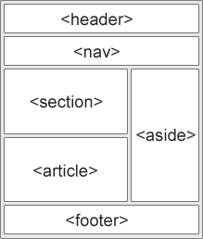
HTML Layout Elements and Techniques
<header> - Defines a header for a document or a section
<nav> - Defines a set of navigation links
<section> - Defines a section in a document
<article> - Defines an independent, self-contained content
<aside> - Defines content aside from the content (like a sidebar)
<footer> - Defines a footer for a document or a section
<details> - Defines additional details that the user can open and close on demand
<summary> - Defines a heading for the <details> element

Slide 96
HTML Layout Techniques
There are four different techniques to create multicolumn layouts. Each technique has its pros and cons:
CSS framework
CSS float property
CSS flexbox
CSS grid

Slide 97
CSS Float Layout
It is common to do entire web layouts using the CSS float property. Float is easy to learn - you just need to remember how the float and clear properties work. Disadvantages: Floating elements are tied to the document flow, which may harm the flexibility.
CSS Flexbox Layout
Use of flexbox ensures that elements behave predictably when the page layout must accommodate different screen sizes and different display devices.
CSS Grid Layout
The CSS Grid Layout Module offers a grid-based layout system, with rows and columns, making it easier to design web pages without having to use floats and positioning.

Slide 98
HTML Responsive Web Design
Responsive web design is about creating web pages that look good on all devices!
A responsive web design will automatically adjust for different screen sizes and viewports.
What is Responsive Web Design?
Responsive Web Design is about using HTML and CSS to automatically resize, hide, shrink, or enlarge, a website, to make it look good on all devices (desktops, tablets, and phones):
Setting The Viewport
To create a responsive website, add the following <meta> tag to all your web pages:
Example
<meta name="viewport" content="width=device-width, initial-scale=1.0">

Slide 99

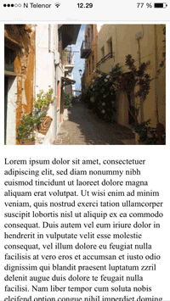
This will set the viewport of your page, which will give the browser instructions on how to control the page's dimensions and scaling.
Here is an example of a web page without the viewport meta tag, and the same web page with the viewport meta tag:
Without the viewport meta tag: With the viewport meta tag:

Slide 100
Responsive Images
Responsive images are images that scale nicely to fit any browser size.
Using the width Property
If the CSS width property is set to 100%, the image will be responsive and scale up and down:
Example
<img src="img_girl.jpg" style="width:100%;">
Using the max-width Property
If the max-width property is set to 100%, the image will scale down if it has to, but never scale up to be larger than its original size:
<img src="img_girl.jpg" style="max-width:100%;height:auto;">

Slide 101
Show Different Images Depending on Browser Width
The HTML <picture> element allows you to define different images for different browser window sizes.
Resize the browser window to see how the image below changes depending on the width:
Example
<picture> <source srcset="img_smallflower.jpg" media="(max-width: 600px)"> <source srcset="img_flowers.jpg" media="(max-width: 1500px)"> <source srcset="flowers.jpg"> <img src="img_smallflower.jpg" alt="Flowers"> </picture>

Slide 102
Responsive Text Size
The text size can be set with a "vw" unit, which means the "viewport width".
That way the text size will follow the size of the browser window:
<h1 style="font-size:10vw">Hello World</h1>
Left Menu

Slide 103
HTML Computer Code Elements
HTML contains several elements for defining user input and computer code.
Example:
<code> x = 5; y = 6; z = x + y; </code>

Slide 104
HTML <kbd> For Keyboard Input
The HTML <kbd> element is used to define keyboard input. The content inside is displayed in the browser's default monospace font.
Example
Define some text as keyboard input in a document:
<p>Save the document by pressing <kbd>Ctrl + S</kbd></p>
HTML <samp> For Program Output
The HTML <samp> element is used to define sample output from a computer program. The content inside is displayed in the browser's default monospace font.
Example
Define some text as sample output from a computer program in a document:
<p>Message from my computer:</p> <p><samp>File not found.<br>Press F1 to continue</samp></p>

Slide 105
HTML <code> For Computer Code
The HTML <code> element is used to define a piece of computer code. The content inside is displayed in the browser's default monospace font.
Example
Define some text as computer code in a document:
<code> x = 5; y = 6; z = x + y; </code>
HTML <var> For Variables
The HTML <var> element is used to define a variable in programming or in a mathematical expression. The content inside is typically displayed in italic.
Example
Define some text as variables in a document:
<p>The area of a triangle is: 1/2 x <var>b</var> x <var>h</var>, where <var>b</var> is the base, and <var>h</var> is the vertical height.</p>

Slide 106
HTML Semantic Elements
What are Semantic Elements?
A semantic element clearly describes its meaning to both the browser and the developer.
Examples of non-semantic elements: <div> and <span> - Tells nothing about its content.
Examples of semantic elements: <form>, <table>, and <article> - Clearly defines its content.

Slide 107
Semantic Elements in HTML
Many web sites contain HTML code like: <div id="nav"> <div class="header"> <div id="footer"> to indicate navigation, header, and footer.
In HTML there are some semantic elements that can be used to define different parts of a web page:
<article>
<aside>
<details>
<figcaption>
<figure>
<footer>
<header>
<main>
<mark>
<nav>
<section>
<summary>
<time>

Slide 108
HTML <section> Element
The <section> element defines a section in a document.
According to W3C's HTML documentation: "A section is a thematic grouping of content, typically with a heading."
Examples of where a <section> element can be used:
Chapters
Introduction
News items
Contact information

Slide 109
HTML <article> Element
The <article> element specifies independent, self-contained content.
An article should make sense on its own, and it should be possible to distribute it independently from the rest of the web site.
Examples of where the <article> element can be used:
Forum posts
Blog posts
User comments
Product cards
Newspaper articles

Slide 110
Nesting <article> in <section> or Vice Versa?
The <article> element specifies independent, self-contained content.
The <section> element defines section in a document.
Can we use the definitions to decide how to nest those elements? No, we cannot!
So, you will find HTML pages with <section> elements containing <article> elements, and <article> elements
containing <section> elements.
HTML <header> Element
The <header> element represents a container for introductory content or a set of navigational links.
A <header> element typically contains:
one or more heading elements (<h1> - <h6>)
logo or icon
authorship information

Slide 111
HTML <footer> Element
The <footer> element defines a footer for a document or section.
A <footer> element typically contains:
authorship information
copyright information
contact information
sitemap
back to top links
related documents
HTML <nav> Element
The <nav> element defines a set of navigation links.

Slide 112
HTML <aside> Element
The <aside> element defines some content aside from the content it is placed in (like a sidebar).
The <aside> content should be indirectly related to the surrounding content.
HTML <figure> and <figcaption> Elements
The <figure> tag specifies self-contained content, like illustrations, diagrams, photos, code listings, etc.
The <figcaption> tag defines a caption for a <figure> element. The <figcaption> element can be placed as the first or as the last child of a <figure> element.

Slide 113
HTML Entities
Character entities are used to display reserved characters in HTML.
A character entity looks like this:
&entity_name;
OR
&#entity_number;
A commonly used entity in HTML is the non-breaking space: &nbsp; A non-breaking space is a space that will not break into a new line.It is used to prevent browsers from truncating spaces in HTML pages.
Examples:
§ 10
10 km/h
10 PM

Slide 114
Character | Entity Name | Entity Number
Greater than sign (>) | &gt; | &#62;
Less than sign (<) | &lt; | &#60;
Ampersand (&) | &amp; | &#38;
Quotation mark (") | &quot; | &#34;
Apostrophe (') | &apos; | &#39;
Euro sign (€) | &euro; | &#8364;
Registered trademark symbol (®) | &reg; | &#174;
Copyright symbol (©) | &copy; | &#169;
Bullet point symbol (•) | &bull; | &#8226;
Em dash (—) | &mdash; | &#8212;

Slide 115
Example:-
<!DOCTYPE html>
<html>
<head>
<title>HTML Entities Example - &euro;</title>
</head>
<body>
<h1>HTML Entities Example - &euro;</h1>
<p>The price for this item is €19.99.</p>
</body>
</html>
HTML Entities Example - €
The price for this item is €19.99.

Slide 116
HTML Symbols
Many mathematical, technical, and currency symbols, are not present on a normal keyboard. To add such symbols to an HTML page, you can use the entity name or the entity number (a decimal or a hexadecimal reference) for the symbol.
Example
Display the euro sign, €, with an entity name, a decimal, and a hexadecimal value:
<p>I will display &euro;</p> <p>I will display &#8364;</p> <p>I will display &#x20AC;</p>
Will display as:
I will display € I will display € I will display €

Slide 117
Symbol | Entity Name | Entity Number
& | Ampersand | &amp;
< | Less than | &lt;
> | Greater than | &gt;
" | Quotation mark | &quot;
' | Apostrophe | &apos;
 | Non-breaking space | &nbsp;
© | Copyright symbol | &copy;
® | Registered trademark symbol | &reg;
™ | Trademark symbol | &trade;
♥ | Heart symbol | &hearts;
♣ | Club symbol | &clubs;
♦ | Diamond symbol | &diams;
♠ | Spade symbol | &spades;
† | Dagger symbol | &dagger;
§ | Section symbol | &sect;

Slide 118
Example:-
<!DOCTYPE html>
<html>
<head>
<title>HTML Entities Example - &copy;</title>
</head>
<body>
<h1>HTML Entities Example - &copy;</h1>
<p>This website is protected by &copy; 2023 MyCompany. All rights reserved.</p>
</body>
</html>
HTML Entities Example - ©
This website is protected by © 2023 MyCompany. All rights reserved.

Slide 119
HTML Charset
To display an HTML page correctly, a web browser must know which character set to use.
From ASCII to UTF-8
ASCII was the first character encoding standard. ASCII defined 128 different characters that could be used on the internet: numbers (0-9), English letters (A-Z), and some special characters like ! $ + - ( ) @ < > .
ISO-8859-1 was the default character set for HTML 4. This character set supported 256 different character codes. HTML 4 also supported UTF-8.
ANSI (Windows-1252) was the original Windows character set. ANSI is identical to ISO-8859-1, except that ANSI has 32 extra characters.
To display an HTML page correctly, a web browser must know the character set used in the page. This is specified in the <meta> tag:
<meta charset="UTF-8">

Slide 120
HTML URL Encode
A URL can be composed of words or an Internet Protocol (IP) address (e.g. 192.68.20.50).
Web browsers request pages from web servers by using a URL.A Uniform Resource Locator (URL) is used to address a document (or other data) on the web.
URLs can only be sent over the Internet using the ASCII character-set. If a URL contains characters outside the ASCII set, the URL has to be converted.
URL encoding converts non-ASCII characters into a format that can be transmitted over the Internet.
URL encoding replaces non-ASCII characters with a "%" followed by hexadecimal digits.
URLs cannot contain spaces. URL encoding normally replaces a space with a plus (+) sign, or %20.

Slide 121
Example:-
<!DOCTYPE html>
<html>
<head>
<title>URL Encoding Example</title>
</head>
<body>
<h1>URL Encoding Example</h1>
<p>Original URL: https://example.com/?search=hello world&category=example</p>
<p>URL Encoded: https://example.com/?search=hello%20world&amp;category=example</p>
</body>
</html>

Slide 122
HTML vs XHTML
HTML | XHTML
HTML is based on SGML (Standard Generalized Markup Language) | XHTML is based on XML (eXtensible Markup Language)
HTML allows some errors and inconsistencies | XHTML is stricter and requires well-formed XML syntax
Tags and attributes are case-insensitive | Tags and attributes are case-sensitive in XHTML
HTML has deprecated elements and attributes | XHTML removes deprecated elements and attributes
Inline event handlers are commonly used in HTML | Inline event handlers are not recommended in XHTML
HTML supports both HTML-style and XML-style comments | XHTML only supports XML-style comments
Empty elements do not require closing tags in HTML | Empty elements must be properly closed with a self-closing tag in XHTML
HTML does not require a DOCTYPE declaration | XHTML requires a DOCTYPE declaration at the beginning of the document

Slide 123
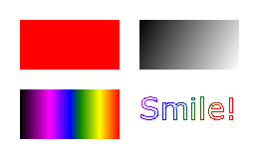
HTML Graphics
HTML Canvas Graphics
The HTML <canvas> element is used to draw graphics on a web page.
The graphic to the left is created with <canvas>. It shows four elements: a red rectangle, a gradient rectangle, a multicolor rectangle, and a multicolor text.

Slide 124
What is HTML Canvas?
The HTML <canvas> element is used to draw graphics, on the fly, via JavaScript.
The <canvas> element is only a container for graphics. You must use JavaScript to actually draw the graphics.
Canvas has several methods for drawing paths, boxes, circles, text, and adding images.
Browser Support
The numbers in the table specify the first browser version that fully supports the <canvas> element.

Slide 125
Canvas Examples
A canvas is a rectangular area on an HTML page. By default, a canvas has no border and no content.
The markup looks like this:
<canvas id="myCanvas" width="200" height="100"></canvas>
Note: Always specify an id attribute (to be referred to in a script), and a width and height attribute to define the size of the canvas. To add a border, use the style attribute.
Here is an example of a basic, empty canvas:

Slide 126

<!DOCTYPE html>
<html>
<body>
<canvas id="myCanvas" width="200" height="100" style="border:1px solid #000000;">
Your browser does not support the HTML canvas tag.
</canvas>
</body>
</html>

Slide 127
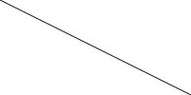
Add a JavaScript
After creating the rectangular canvas area, you must add a JavaScript to do the drawing.
Here are some examples:

Slide 128
<!DOCTYPE html>
<html>
<body>
<canvas id="myCanvas" width="200" height="100" style="border:1px solid #d3d3d3;">
Your browser does not support the HTML canvas tag.</canvas>
<script>
var c = document.getElementById("myCanvas");
var ctx = c.getContext("2d");
ctx.moveTo(0,0);
ctx.lineTo(200,100);
ctx.stroke();
</script>
</body>
</html>

Slide 129
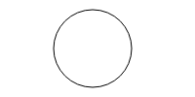
<!DOCTYPE html>
<html>
<body>
<canvas id="myCanvas" width="200" height="100" style="border:1px solid #d3d3d3;">
Your browser does not support the HTML canvas tag.</canvas>
<script>
var c = document.getElementById("myCanvas");
var ctx = c.getContext("2d");
ctx.beginPath();
ctx.arc(95,50,40,0,2*Math.PI);
ctx.stroke();
</script>
</body>
</html>

Slide 130

<!DOCTYPE html>
<html>
<body>
<canvas id="myCanvas" width="200" height="100" style="border:1px solid #d3d3d3;">
Your browser does not support the HTML canvas tag.</canvas>
<script>
var c = document.getElementById("myCanvas");
var ctx = c.getContext("2d");
ctx.font = "30px Arial";
ctx.fillText("Hello World",10,50);
</script>
</body>
</html>

Slide 131
<!DOCTYPE html>
<html>
<body>
<canvas id="myCanvas" width="200" height="100" style="border:1px solid #d3d3d3;">
Your browser does not support the HTML canvas tag.</canvas>
<script>
var c = document.getElementById("myCanvas");
var ctx = c.getContext("2d");
// Create gradient
var grd = ctx.createLinearGradient(0,0,200,0);
grd.addColorStop(0,"red");
grd.addColorStop(1,"white");

Slide 132

// Fill with gradient
ctx.fillStyle = grd;
ctx.fillRect(10,10,150,80);
</script>
</body>
</html>

Slide 133
HTML SVG Graphics
What is SVG?
SVG stands for Scalable Vector Graphics
SVG is used to define graphics for the Web
The HTML <svg> Element
The HTML <svg> element is a container for SVG graphics.
SVG has several methods for drawing paths, boxes, circles, text, and graphic images.

Slide 134

<!DOCTYPE html>
<html>
<body>
<svg width="100" height="100">
<circle cx="50" cy="50" r="40"
stroke="green" stroke-width="4" fill="yellow" />
Sorry, your browser does not support inline SVG.
</svg>
</body>
</html>

Slide 135
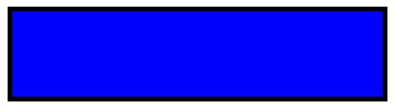
<!DOCTYPE html>
<html>
<body>
<svg width="400" height="100">
<rect width="400" height="100"
style="fill:rgb(0,0,255);stroke-width:10;stroke:rgb(0,0,0)" />
Sorry, your browser does not support inline SVG.
</svg>
</body>
</html>

Slide 136
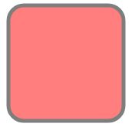
<!DOCTYPE html>
<html>
<body>
<svg width="400" height="180">
<rect x="50" y="20" rx="20" ry="20" width="150" height="150"
style="fill:red;stroke:black;stroke-width:5;opacity:0.5" />
Sorry, your browser does not support inline SVG.
</svg>
</body>
</html>

Slide 137

<!DOCTYPE html>
<html>
<body>
<svg width="300" height="200">
<polygon points="100,10 40,198 190,78 10,78 160,198"
style="fill:lime;stroke:purple;stroke-width:5;fill-rule:evenodd;" />
Sorry, your browser does not support inline SVG.
</svg>
</body>
</html>

Slide 138
<!DOCTYPE html>
<html>
<body>
<svg height="130" width="500">
<defs>
<linearGradient id="grad1" x1="0%" y1="0%" x2="100%" y2="0%">
<stop offset="0%"
style="stop-color:rgb(255,255,0);stop-opacity:1" />
<stop offset="100%"
style="stop-color:rgb(255,0,0);stop-opacity:1" />

Slide 139

</linearGradient>
</defs>
<ellipse cx="100" cy="70" rx="85" ry="55" fill="url(#grad1)" />
<text fill="#ffffff" font-size="45" font-family="Verdana"
x="50" y="86">SVG</text>
Sorry, your browser does not support inline SVG.
</svg>
</body>
</html>

Slide 140
HTML Geolocation API
The getCurrentPosition() method is used to return the user's position.
The second parameter of the getCurrentPosition() method is used to handle errors.
The getCurrentPosition() method returns an object on success.
watchPosition() - Returns the current position of the user and continues to return updated position as the user moves (like the GPS in a car).
clearWatch() - Stops the watchPosition() method.

Slide 141
<!DOCTYPE html>
<html>
<body>
<p>Click the button to get your coordinates.</p>
<button onclick="getLocation()">Try It</button>
<p id="demo"></p>
<script>
var x = document.getElementById("demo");
function getLocation() {
if (navigator.geolocation) {
navigator.geolocation.getCurrentPosition(showPosition);
} else {
x.innerHTML = "Geolocation is not supported by this browser.";
}
}

Slide 142
function showPosition(position) {
x.innerHTML = "Latitude: " + position.coords.latitude +
"<br>Longitude: " + position.coords.longitude;
}
</script>
</body>
</html>

Slide 143
HTML Drag and Drop API
Drag and drop is a very common feature. It is when you "grab" an object and drag it to a different location.
To make an element draggable, set the draggable attribute to true:
<img draggable="true">
The ondragstart attribute calls a function, drag(event), that specifies what data to be dragged.
The ondragover event specifies where the dragged data can be dropped.

Slide 144
<!DOCTYPE HTML> <html> <head> <script> function allowDrop(ev) { ev.preventDefault(); } function drag(ev) { ev.dataTransfer.setData("text", ev.target.id); } function drop(ev) { ev.preventDefault(); var data = ev.dataTransfer.getData("text"); ev.target.appendChild(document.getElementById(data)); } </script> </head>

Slide 145
<body> <div id="div1" ondrop="drop(event)" ondragover="allowDrop(event)"></div> <img id="drag1" src="img_logo.gif" draggable="true" ondragstart="drag(event)" width="336" height="69"> </body> </html>

Slide 146
HTML Web Storage API
With web storage, web applications can store data locally within the user's browser.
HTML web storage provides two objects for storing data on the client:
window.localStorage - stores data with no expiration date
window.sessionStorage - stores data for one session (data is lost when the browser tab is closed)
if (typeof(Storage) !== "undefined") { } else { }

Slide 147
Web Worker
A web worker is a JavaScript that runs in the background, independently of other scripts, without affecting the performance of the page. You can continue to do whatever you want: clicking, selecting things, etc., while the web worker runs in the background.
Check Web Worker Support
if (typeof(Worker) !== "undefined") { // Yes! Web worker support! // Some code..... } else { // Sorry! No Web Worker support.. }

Slide 148
Create a Web Worker File
Now, let's create our web worker in an external JavaScript.
Here, we create a script that counts. The script is stored in the "demo_workers.js" file:
var i = 0; function timedCount() { i = i + 1; postMessage(i); setTimeout("timedCount()",500); } timedCount();

Slide 149
Create a Web Worker Object
The following lines checks if the worker already exists, if not - it creates a new web worker object and runs the code in "demo_workers.js":
if (typeof(w) == "undefined") { w = new Worker("demo_workers.js"); }
Terminate a Web Worker
When a web worker object is created, it will continue to listen for messages (even after the external script is finished) until it is terminated.
To terminate a web worker, and free browser/computer resources, use the terminate() method:
w.terminate();

Slide 150
Server-Sent Events - One Way Messaging
A server-sent event is when a web page automatically gets updates from a server.
This was also possible before, but the web page would have to ask if any updates were available. With server-sent events, the updates come automatically.
Examples: Facebook/Twitter updates, stock price updates
Receive Server-Sent Event Notifications
Example
var source = new EventSource("demo_sse.php"); source.onmessage = function(event) { document.getElementById("result").innerHTML += event.data + "<br>"; };

Slide 151
Check Server-Sent Events Support
if(typeof(EventSource) !== "undefined") { // Yes! Server-sent events support! // Some code..... } else { // Sorry! No server-sent events support.. }

Slide 152
Server-Side Code Example
<?php header('Content-Type: text/event-stream'); header('Cache-Control: no-cache'); $time = date('r'); echo "data: The server time is: {$time}\n\n"; flush(); ?>

Slide 153
HTML MEDIA
Multimedia:
Multimedia comes in many different formats. It can be almost anything you can hear or see, like images, music, sound, videos, records, films, animations, and more.
Web pages often contain multimedia elements of different types and formats.
Browser Support:
The first web browsers had support for text only, limited to a single font in a single color.
Later came browsers with support for colors, fonts, images, and multimedia!

Slide 154
Multimedia Formats:
Multimedia elements (like audio or video) are stored in media files.
The most common way to discover the type of a file, is to look at the file extension.
Multimedia files have formats and different extensions like: .wav, .mp3, .mp4, .mpg, .wmv, and .avi.

Slide 155

Common Video Formats:
There are many video formats out there. The MP4, WebM, and Ogg formats are supported by HTML. The MP4 format is recommended by YouTube.

Slide 156
Common Audio Formats:
MP3 is the best format for compressed recorded music. The term MP3 has become synonymous with digital music.
If your website is about recorded music, MP3 is the choice.

Slide 157
HTML Video
The HTML <video> element is used to show a video on a web page.
The HTML <video> Element
To show a video in HTML, use the <video> element:
Example:
<video width="320" height="240" controls> <source src="movie.mp4" type="video/mp4"> <source src="movie.ogg" type="video/ogg"> Your browser does not support the video tag. </video>

Slide 158
How it Works:
The controls attribute adds video controls, like play, pause, and volume.
It is a good idea to always include width and height attributes. If height and width are not set, the page might flicker while the video loads.
The <source> element allows you to specify alternative video files which the browser may choose from. The browser will use the first recognized format.
The text between the <video> and </video> tags will only be displayed in browsers that do not support the <video> element.

Slide 159
HTML <video> Autoplay :
To start a video automatically, use the autoplay attribute:
Example
<video width="320" height="240" autoplay> <source src="movie.mp4" type="video/mp4"> <source src="movie.ogg" type="video/ogg"> Your browser does not support the video tag. </video>

Slide 160
HTML Video - Methods, Properties, and Events
The HTML DOM defines methods, properties, and events for the <video> element.
This allows you to load, play, and pause videos, as well as setting duration and volume.
There are also DOM events that can notify you when a video begins to play, is paused, etc.
HTML Video Tags

Slide 161
Tag​ | Description​
<video>​ | Defines a video or movie​
<source>​ | Defines multiple media resources for media elements, such as <video> and <audio>​
<track>​ | Defines text tracks in media players​

Slide 162
HTML Audio
The HTML <audio> element is used to play an audio file on a web page.
The HTML <audio> Element
To play an audio file in HTML, use the <audio> element:
Example
<audio controls> <source src="horse.ogg" type="audio/ogg"> <source src="horse.mp3" type="audio/mpeg"> Your browser does not support the audio element. </audio>

Slide 163
HTML Audio - How It Works
The controls attribute adds audio controls, like play, pause, and volume.
The <source> element allows you to specify alternative audio files which the browser may choose from. The browser will use the first recognized format.
The text between the <audio> and </audio> tags will only be displayed in browsers that do not support the <audio> element.

Slide 164
HTML <audio> Autoplay
To start an audio file automatically, use the autoplay attribute:
Example
<audio controls autoplay> <source src="horse.ogg" type="audio/ogg"> <source src="horse.mp3" type="audio/mpeg"> Your browser does not support the audio element. </audio>

Slide 165
HTML Audio - Methods, Properties, and Events
The HTML DOM defines methods, properties, and events for the <audio> element.
This allows you to load, play, and pause audios, as well as set duration and volume.
There are also DOM events that can notify you when an audio begins to play, is paused, etc.
For a full DOM reference, go to our HTML Audio/Video DOM Reference.

Slide 166
HTML Plug-ins
Plug-ins
Plug-ins were designed to be used for many different purposes:
To run Java applets
To run Microsoft ActiveX controls
To display Flash movies
To display maps
To scan for viruses
To verify a bank id

Slide 167
The <object> Element:
The <object> element is supported by all browsers.
The <object> element defines an embedded object within an HTML document.
It was designed to embed plug-ins (like Java applets, PDF readers, and Flash Players) in web pages, but can also be used to include HTML in HTML:

Slide 168
Example:
<object width="100%" height="500px" data="snippet.html"></object>
Try it Your
Or images if you like:
Example
<object data="audi.jpeg"></object>

Slide 169
The <embed> Element:
The <embed> element is supported in all major browsers.
The <embed> element also defines an embedded object within an HTML document.
Web browsers have supported the <embed> element for a long time. However, it has not been a part of the HTML specification before HTML5.
Example:
<embed src="audi.jpeg">
The <embed> element can also be used to include HTML in HTML:
Example:
<embed width="100%" height="500px" src="snippet.html">

Slide 170
HTML YouTube Videos
Converting videos to different formats can be difficult and time-consuming.
An easier solution is to let YouTube play the videos in your web page.
YouTube Video Id:
YouTube will display an id (like tgbNymZ7vqY), when you save (or play) a video.
You can use this id, and refer to your video in the HTML code.

Slide 171
Playing a YouTube Video in HTML:
To play your video on a web page, do the following:
Upload the video to YouTube
Take a note of the video id
Define an <iframe> element in your web page
Let the src attribute point to the video URL
Use the width and height attributes to specify the dimension of the player
Add any other parameters to the URL (see below)
Example
<iframe width="420" height="315" src="https://www.youtube.com/embed/tgbNymZ7vqY"> </iframe>

Slide 172
YouTube Autoplay + Mute
You can let your video start playing automatically when a user visits the page, by adding autoplay=1 to the YouTube URL. However, automatically starting a video is annoying for your visitors!
Note: Chromium browsers do not allow autoplay in most cases. However, muted autoplay is always allowed.
Add mute=1 after autoplay=1 to let your video start playing automatically (but muted).
YouTube - Autoplay + Muted
<iframe width="420" height="315" src="https://www.youtube.com/embed/tgbNymZ7vqY?autoplay=1&mute=1"> </iframe>

Slide 173
YouTube Playlist:
A comma separated list of videos to play (in addition to the original URL).
YouTube Loop:
Add loop=1 to let your video loop forever.
Value 0 (default): The video will play only once.
Value 1: The video will loop (forever).
YouTube - Loop
<iframe width="420" height="315" src="https://www.youtube.com/embed/tgbNymZ7vqY?playlist=tgbNymZ7vqY&loop=1"> </iframe>
Try it Your

Slide 174
YouTube Controls:
Add controls=0 to not display controls in the video player.
Value 0: Player controls does not display.
Value 1 (default): Player controls display.
YouTube – Controls:
<iframe width="420" height="315" src="https://www.youtube.com/embed/tgbNymZ7vqY?controls=0"> </iframe>

Slide 175
HTML FORMS
An HTML form is used to collect user input. The user input is most often sent to a server for processing.
The <form> Element
The HTML <form> element is used to create an HTML form for user input:
<form> . form elements . </form>
The <form> element is a container for different types of input elements, such as: text fields, checkboxes, radio buttons, submit buttons, etc.

Slide 176
The <input> Element
The HTML <input> element is the most used form element.
An <input> element can be displayed in many ways, depending on the type attribute.
The <label> Element
The <label> tag defines a label for many form elements.
The <label> element is useful for screen-reader users, because the screen-reader will read out loud the label when the user focuses on the input element.
The <label> element also helps users who have difficulty clicking on very small regions (such as radio buttons or checkboxes) - because when the user clicks the text within the <label> element, it toggles the radio button/checkbox.
The for attribute of the <label> tag should be equal to the id attribute of the <input> element to bind them together.

Slide 177
HTML Form Elements
The < select > element
The <select> element defines a drop-down list:
Example:
<label for="cars">Choose a car:</label> <select id="cars" name="cars"> <option value="volvo">Volvo</option> <option value="saab">Saab</option> <option value="fiat">Fiat</option> <option value="audi">Audi</option> </select>

Slide 178
< option > element
The <option> elements defines an option that can be selected.
By default, the first item in the drop-down list is selected.
To define a pre-selected option, add the 'selected' attribute to the option
Use the 'size' attribute to specify the number of visible values
Use the multiple attribute to allow the user to select more than one value:
Example:
<label for="cars">Choose a car:</label> <select id="cars" name="cars" size="4" multiple> <option value="volvo">Volvo</option> <option value="saab">Saab</option> <option value="fiat">Fiat</option> <option value="audi">Audi</option> </select>

Slide 179
The <textarea> Element
The < textarea > element defines a multi-line input field (a text area):
< textarea name="message" rows="10" cols="30" > The cat was playing in the garden. < / textarea >
The rows attribute specifies the visible number of lines in a text area.
The cols attribute specifies the visible width of a text area.

Slide 180
The <button> Element
The <button> element defines a clickable button:
<button type="button" onclick="alert('Hello World!')">Click Me!</button>

Slide 181
The < fieldset > and < legend > Elements
The <fieldset> element is used to group related data in a form.
The <legend> element defines a caption for the <fieldset> element.
<form action="/action_page.php"> <fieldset> <legend>Personalia:</legend> <label for="fname">First name:</label><br> <input type="text" id="fname" name="fname" value="John"><br> <label for="lname">Last name:</label><br> <input type="text" id="lname" name="lname" value="Doe"><br><br> <input type="submit" value="Submit"> </fieldset>
</form>

Slide 182
The <datalist> Element
The <datalist> element specifies a list of pre-defined options for an <input> element.
Users will see a drop-down list of the pre-defined options as they input data.
The list attribute of the <input> element, must refer to the id attribute of the <datalist> element.
<form action="/action_page.php"> <input list="browsers"> <datalist id="browsers"> <option value="Internet Explorer"> <option value="Firefox"> <option value="Chrome"> <option value="Opera"> <option value="Safari"> </datalist> </form>

Slide 183
The <output> Element
The <output> element represents the result of a calculation (like one performed by a script).
Example
Perform a calculation and show the result in an <output> element:
< form action="/action_page.php" oninput="x.value=parseInt(a.value)+parseInt(b.value)"> 0 <input type="range" id="a" name="a" value="50"> 100 + <input type="number" id="b" name="b" value="50"> = <output name="x" for="a b"></output> <br><br> <input type="submit"> </form>

Slide 184
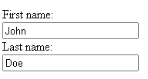
HTML Input Attributes
The value Attribute
The input value attribute specifies an initial value for an input field.
<form action="/action_page.php">
<label for="fname">First name:</label><br>
<input type="text" id="fname" name="fname" value="John"><br>
<label for="lname">Last name:</label><br>
<input type="text" id="lname" name="lname" value="Doe"><br><br>
<input type="submit" value="Submit">
</form>

Slide 185
The readonly Attribute
The input readonly attribute specifies that an input field is read-only.
A read-only input field cannot be modified (however, a user can tab to it, highlight it, and copy the text from it).
The value of a read-only input field will be sent when submitting the form.
<form>
<label for="fname">First name:</label><br>
<input type="text" id="fname" name="fname" value="John" readonly><br>
<label for="lname">Last name:</label><br>
<input type="text" id="lname" name="lname" value="Doe">
</form>

Slide 186
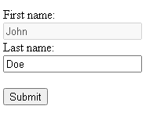
The disabled Attribute
The input disabled attribute specifies that an input field should be disabled.
A disabled input field is unusable and un-clickable.
The value of a disabled input field will not be sent when submitting the form!
<form>
<label for="fname">First name:</label><br>
<input type="text" id="fname" name="fname" value="John" disabled><br>
<label for="lname">Last name:</label><br>
<input type="text" id="lname" name="lname" value="Doe">
</form>

Slide 187
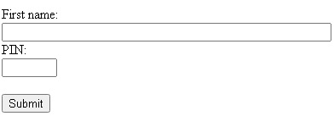
The size Attribute
The input size attribute specifies the visible width, in characters, of an input field.
The default value for size is 20.
The size attribute works with the following input types: text, search, tel, url, email, and password.
<form>
<label for="fname">First name:</label><br>
<input type="text" id="fname" name="fname" size="50"><br>
<label for="pin">PIN:</label><br>
<input type="text" id="pin" name="pin" size="4">
</form>

Slide 188
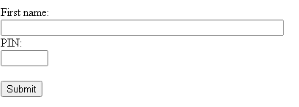
The maxlength Attribute
The input maxlength attribute specifies the maximum number of characters allowed in an input field.
<form>
<label for="fname">First name:</label><br>
<input type="text" id="fname" name="fname" size="50"><br>
<label for="pin">PIN:</label><br>
<input type="text" id="pin" name="pin" maxlength="4" size="4">
</form>

Slide 189
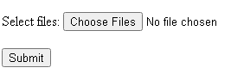
The multiple Attribute
The input multiple attribute specifies that the user is allowed to enter more than one value in an input field.
The multiple attribute works with the following input types: email, and file.
<form>
<label for="files">Select files:</label>
<input type="file" id="files" name="files" multiple>
</form>

Slide 190
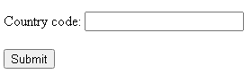
The pattern Attribute
The input pattern attribute specifies a regular expression that the input field's value is checked against, when the form is submitted.
The pattern attribute works with the following input types: text, date, search, url, tel, email, and password.
<form>
<label for="country_code">Country code:</label>
<input type="text" id="country_code" name="country_code"
pattern="[A-Za-z]{3}" title="Three letter country code">
</form>

Slide 191
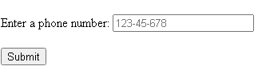
The placeholder Attribute
The input placeholder attribute specifies a short hint that describes the expected value of an input field (a sample value or a short description of the expected format).
The short hint is displayed in the input field before the user enters a value.
The placeholder attribute works with the following input types: text, search, url, tel, email, and password.
<form>
<label for="phone">Enter a phone number:</label>
<input type="tel" id="phone" name="phone"
placeholder="123-45-678"
pattern="[0-9]{3}-[0-9]{2}-[0-9]{3}">
</form>

Slide 192
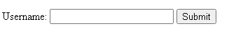
The required Attribute
The input required attribute specifies that an input field must be filled out before submitting the form.
The required attribute works with the following input types: text, search, url, tel, email, password, date pickers, number, checkbox, radio, and file.
<form>
<label for="username">Username:</label>
<input type="text" id="username" name="username" required>
</form>

Slide 193
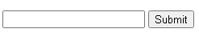
The list Attribute
The input list attribute refers to a <datalist> element that contains pre-defined options for an <input> element.
<form>
<input list="browsers">
<datalist id="browsers">
<option value="Internet Explorer">
<option value="Firefox">
<option value="Chrome">
<option value="Opera">
<option value="Safari">
</datalist>
</form>

Slide 194
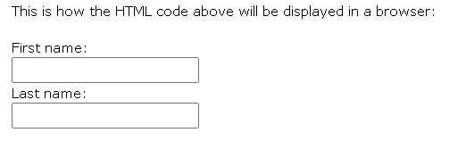
HTML INPUT TYPES
Input Type Text
It defines a single-line text input field.
<form> <label for="fname">First name:</label><br> <input type="text" id="fname" name="fname"><br> <label for="lname">Last name:</label><br> <input type="text" id="lname" name="lname"> </form>

Slide 195
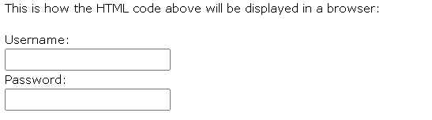
Input Type Password
It defines a password field.
<form> <label for="username">Username:</label><br> <input type="text" id="username" name="username"><br> <label for="pwd">Password:</label><br> <input type="password" id="pwd" name="pwd"> </form>

Slide 196
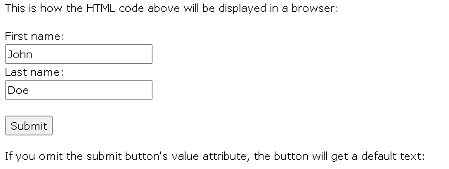
Input Type Submit
It defines a button for submitting form data to a form-handler.
The form-handler is typically a server page with a script for processing input data.
The form-handler is specified in the form's action attribute:
<form action="/action_page.php"> <label for="fname">First name:</label><br> <input type="text" id="fname" name="fname" value="John"><br> <label for="lname">Last name:</label><br> <input type="text" id="lname" name="lname" value="Doe"><br><br> <input type="submit" value="Submit"> </form>

Slide 197
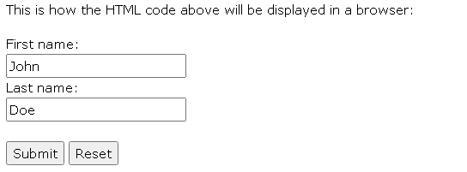
Input Type Reset
It defines a reset button that will reset all form values to their default values.
<form action="/action_page.php"> <label for="fname">First name:</label><br> <input type="text" id="fname" name="fname" value="John"><br> <label for="lname">Last name:</label><br> <input type="text" id="lname" name="lname" value="Doe"><br><br> <input type="submit" value="Submit"> <input type="reset"> </form>

Slide 198
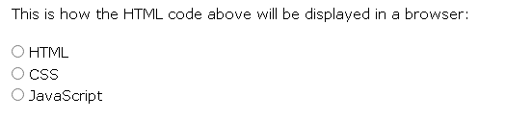
Input Type Radio
It defines a radio button.
Radio buttons let a user select ONLY ONE of a limited number of choices.
<p>Choose your favorite Web language:</p> <form> <input type="radio" id="html" name="fav_language" value="HTML"> <label for="html">HTML</label><br> <input type="radio" id="css" name="fav_language" value="CSS"> <label for="css">CSS</label><br> <input type="radio" id="javascript" name="fav_language" value="JavaScript"> <label for="javascript">JavaScript</label> </form>

Slide 199
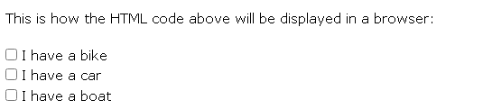
Input Type Checkbox
It defines a checkbox.
Checkboxes let a user select ZERO or MORE options of a limited number of choices.
<form> <input type="checkbox" id="vehicle1" name="vehicle1" value="Bike"> <label for="vehicle1"> I have a bike</label><br> <input type="checkbox" id="vehicle2" name="vehicle2" value="Car"> <label for="vehicle2"> I have a car</label><br> <input type="checkbox" id="vehicle3" name="vehicle3" value="Boat"> <label for="vehicle3"> I have a boat</label> </form>

Slide 200
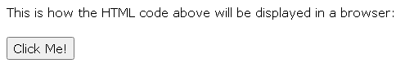
Input Type Button
It defines a button.
<input type="button" onclick="alert('Hello World!')" value="Click Me!">
Input Type Color
It is used for input fields that should contain a color.
Depending on browser support, a color picker can show up in the input field.
<form> <label for="favcolor">Select your favorite color:</label> <input type="color" id="favcolor" name="favcolor"> </form>

Slide 201

Input Type Date
It is used for input fields that should contain a date.
Depending on browser support, a date picker can show up in the input field.
<form> <label for="birthday">Birthday:</label> <input type="date" id="birthday" name="birthday"> </form>
Input Type Datetime-local
It specifies a date and time input field, with no time zone.
Depending on browser support, a date picker can show up in the input field.
<form> <label for="birthdaytime">Birthday (date and time):</label> <input type="datetime-local" id="birthdaytime" name="birthdaytime"> </form>

Slide 202
Input Type Email
It is used for input fields that should contain an e-mail address.
Depending on browser support, the e-mail address can be automatically validated when submitted.
Some smartphones recognize the email type and add ".com" to the keyboard to match email input.
<form> <label for="email">Enter your email:</label> <input type="email" id="email" name="email"> </form>

Slide 203

Input Type Image
It defines an image as a submit button.
The path to the image is specified in the src attribute.
<form> <input type="image" src="img_submit.gif" alt="Submit" width="48" height="48"> </form>

Slide 204

Input Type File
It defines a file-select field and a "Browse" button for file uploads.
<form> <label for="myfile">Select a file:</label> <input type="file" id="myfile" name="myfile"> </form>

Slide 205

Input Type Hidden
It defines a hidden input field (not visible to a user).
A hidden field lets web developers include data that cannot be seen or modified by users when a form is submitted.
A hidden field often stores what database record that needs to be updated when the form is submitted.
<form> <label for="fname">First name:</label> <input type="text" id="fname" name="fname"><br><br> <input type="hidden" id="custId" name="custId" value="3487"> <input type="submit" value="Submit"> </form>

Slide 206

Input Type Range
It defines a control for entering a number whose exact value is not important (like a slider control). Default range is 0 to 100. However, you can set restrictions on what numbers are accepted with the min, max, and step attributes:
<form> <label for="vol">Volume (between 0 and 50):</label> <input type="range" id="vol" name="vol" min="0" max="50"> </form>

Slide 207

Input Type Search
It is used for search fields (a search field behaves like a regular text field).
<form> <label for="gsearch">Search Google:</label> <input type="search" id="gsearch" name="gsearch"> </form>

Slide 208

Input Type Url
It is used for input fields that should contain a URL address.
Depending on browser support, the url field can be automatically validated when submitted.
Some smartphones recognize the url type, and adds ".com" to the keyboard to match url input.
<form> <label for="homepage">Add your homepage:</label> <input type="url" id="homepage" name="homepage"> </form>

Slide 209
HTML Input form Attributes
The form Attribute
The input form attribute specifies the form the <input> element belongs to.
The value of this attribute must be equal to the id attribute of the <form> element it belongs to.
Example:
An input field located outside of the HTML form (but still a part of the form):
<form action="/action_page.php" id="form1"> <label for="fname">First name:</label> <input type="text" id="fname" name="fname"><br><br> <input type="submit" value="Submit"> </form> <label for="lname">Last name:</label> <input type="text" id="lname" name="lname" form="form1">

Slide 210


Slide 211
The formaction Attribute
The input formaction attribute specifies the URL of the file that will process the input when the form is submitted.
This attribute overrides the action attribute of the <form> element.
The formaction attribute works with the following input types: submit and image.
Example
An HTML form with two submit buttons, with different actions:
<form action="/action_page.php"> <label for="fname">First name:</label> <input type="text" id="fname" name="fname"><br><br> <label for="lname">Last name:</label> <input type="text" id="lname" name="lname"><br><br> <input type="submit" value="Submit"> <input type="submit" formaction="/action_page2.php" value="Submit as Admin"> </form>

Slide 212



Slide 213
The formenctype Attribute
The input formenctype attribute specifies how the form-data should be encoded when submitted (only for forms with method="post").
This attribute overrides the enctype attribute of the <form> element.
The formenctype attribute works with the following input types: submit and image.
Example
A form with two submit buttons. The first sends the form-data with default encoding, the second sends the form-data encoded as "multipart/form-data":
<form action="/action_page_binary.asp" method="post"> <label for="fname">First name:</label> <input type="text" id="fname" name="fname"><br><br> <input type="submit" value="Submit"> <input type="submit" formenctype="multipart/form-data" value="Submit as Multipart/form-data"> </form>

Slide 214



Slide 215
The formtarget Attribute
The input formtarget attribute specifies a name or a keyword that indicates where to display the response that is received after submitting the form.
Example
A form with two submit buttons, with different target windows:
<form action="/action_page.php"> <label for="fname">First name:</label> <input type="text" id="fname" name="fname"><br><br> <label for="lname">Last name:</label> <input type="text" id="lname" name="lname"><br><br> <input type="submit" value="Submit"> <input type="submit" formtarget="_blank" value="Submit to a new window/tab"> </form>

Slide 216
The novalidate Attribute
The novalidate attribute is a <form> attribute.
When present, novalidate specifies that all of the form-data should not be validated when submitted.
Example
Specify that no form-data should be validated on submit:
<form action="/action_page.php" novalidate> <label for="email">Enter your email:</label> <input type="email" id="email" name="email"><br><br> <input type="submit" value="Submit"> </form>

Slide 217
THANK YOU

